Slide 1
PERFORMANCE AND POTENTIAL APPRAISAL

Slide 2
Nature of Performance Management
Performance Management
Processes used to identify, encourage, measure, evaluate, improve, and reward employee performance
Provide information to employees about their performance.
Clarify organizational performance expectations.
Identify the development steps that are needed to enhance employee performance.
Document performance for personnel actions.
Provide rewards for achieving performance objectives

Slide 3
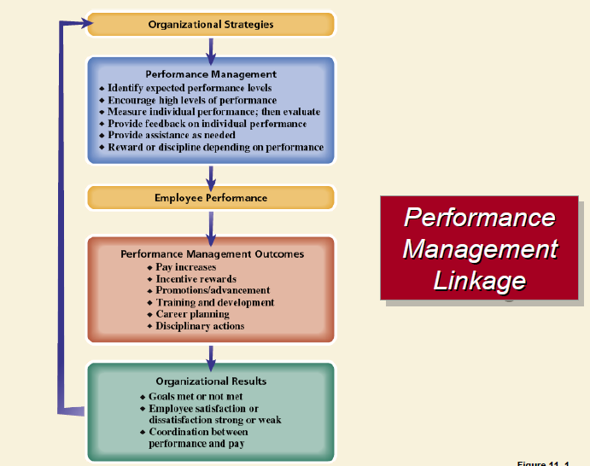

Slide 4
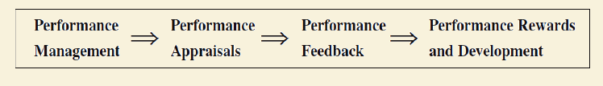
Difference Between Performance Management Performance Appraisals
Performance Management
Processes used to identify, encourage, measure, evaluate, improve, and reward employee performance
Performance Appraisal
The process of evaluating how well employees perform their jobs and then communicating that information to the employees.

Slide 5
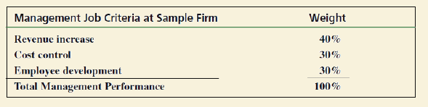
Identifying and Measuring Employee Performance
Performance
What an employee does and does not do.
Quantity of output
Timeliness of output
Cooperativeness
Quality of output Presence at work
Job Criteria
Important elements in a given job

Slide 6
Performance Standards
Performance Standards
Expected levels of performance
Benchmarks, goals, and targets
Characteristics of well-defined standards
Realistic
Measurable
Clearly understood

Slide 7
Performance Appraisal
Performance Appraisal (PA)
The process of evaluating how well employees perform their jobs when compared to a set of standards, and then communicating the information to employees.
Informal Appraisal
Day-to-day contacts, largely undocumented
Systematic Appraisal
Formal contact at regular time intervals, usually documented

Slide 8
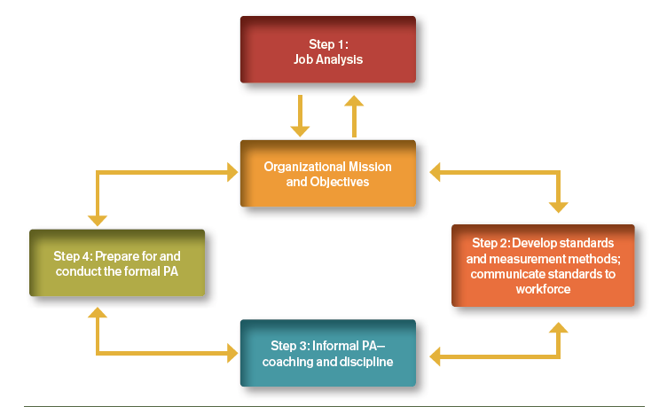
The Performance Appraisal Process

Slide 9
Why Do We Conduct Performance Appraisals?
Communicating
Decision Making (Evaluating)
Motivating (Developing)
Evaluating and Motivating (Development)
Evaluating is about assessing past performance, and motivating is about developing employees to improve their future performance.

Slide 10
Performance appraisal has three basic functions: (1) to provide adequate feedback to each person on his or her performance; (2) to serve as a basis for modifying or changing behavior toward more effective working habits; and (3) to provide data to managers with which they may judge future job assignments and compensation

Slide 11
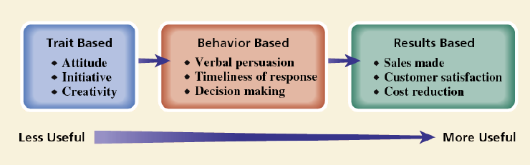
Types of Information evaluated
Traits : identify the physical or psychological characteristics of a person
Behaviors are the actions taken by individuals (the things that they do and say ).
Results are measure of the goals achieved through a work process

Slide 12
Criticisms of Performance Appraisal
Focus is too much on the individual and does little to develop employees.
Employees and supervisors believe the appraisal process is seriously flawed.
Appraisals are inconsistent, short-term oriented, subjective, and useful only at the extremes of performance

Slide 13
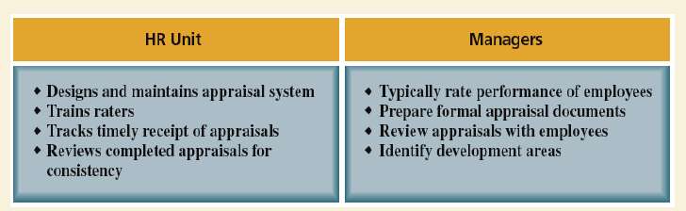
Typical Division of HR Responsibilities: Performance Appraisal

Slide 14
Who conducts appraisal
Supervisors who rate their subordinates
Employees who rate their supervisors
Team members who rate each other
Employees’ self-appraisal
Outside sources rating employees
Multisource (360° feedback) appraisal

Slide 15
Employee rating managers
Advantages
Helps in identifying competent managers
Serves to make managers more responsive to employees
Can contribute to the career development of managers
Disadvantages
Negative reactions by managers to employee ratings
Subordinates’ fear of reprisals may inhibit them from giving realistic (negative) ratings
Ratings are useful only for self-improvement purposes

Slide 16
Team/peer rating
Advantages
Helps improve the performance of lower-rated individuals
Peers have opportunity to observe other peers.
Peer appraisals focus on individual contributions to teamwork and team performance.
Disadvantages
Can negatively affect working relationships.
Can create difficulties for managers in determining individual performance.
Organizational use of individual performance appraisals can hinder the development of teamwork

Slide 17
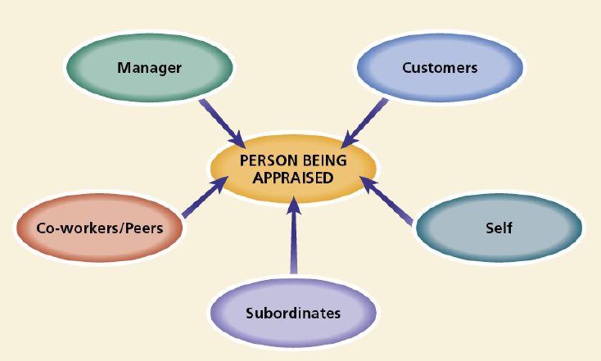
Multisource appraisal

Slide 18
Advantages of Multi-Source Appraisal
Improved Self-Awareness
Enhanced Development and Growth
Reduced Bias and Increased Fairness
Increased Accountability and Engagement
Improved Communication and Collaboration
Identification of High-Potential Employees
Alignment with Organizational Goals

Slide 19
Disadvantages of Multi-Source Appraisal:
Time-Consuming and Resource-Intensive
Potential for Biased or Conflicting Feedback
Anonymity Concerns
Information Overload and Misinterpretation
Lack of Actionable Steps
Negative Impact on Morale
Requires Training and Proper Implementation
Costly to Implement

Slide 20
Advantages of Multi-Source Appraisal:
Improved Self-Awarenes
Enhanced Development and Growth
Reduced Bias and Increased Fairness
Increased Accountability and Engagement
Improved Communication and Collaboration
Identification of High-Potential Employee

Slide 21
Disadvantages of Multi-Source Appraisal
Potential for Biased or Conflicting Feedback
Anonymity Concerns
Information Overload and Misinterpretation
Lack of Actionable Steps
Negative Impact on Morale
Requires Training and Proper Implementation
costly to impliment

Slide 22
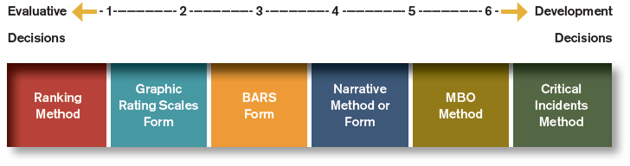
Performance Appraisal Measurement Methods and Forms

Slide 23
Category scaling method
Graphic Rating Scale
A scale that allows the rater to indicate an employee’s performance on a continuum of job behaviors.
Aspects of performance measured:
Descriptive categories, job duties, and behavioral dimensions
Behavioral rating scales (e.g., BARS)

Slide 24
Drawbacks
Restrictions on the range of possible rater responses
Differences in the interpretations of the meanings of scale items and scale ranges by raters
Poorly designed scales that encourage rater errors
Rating form deficiencies limit effectiveness of the appraisal

Slide 25
Behavioral / objective method
Behavioral Rating Approach
Assesses employees’ behaviors instead of other characteristics
Consists of a series of scales created by:
Identifying important job dimensions
Creating statements describing a range of desired and undesirable behaviors (anchors)
Types of behavioral scales
Behaviorally anchored rating scales (BARS)
Behavioral observation scales (BOS)
Behavioral expectation scales (BES)

Slide 26
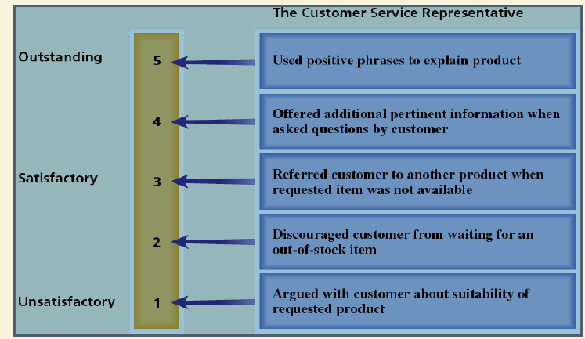
Behaviorally-Anchored Rating Scale for Customer Service Skills

Slide 27
the BARS technique begins by selecting a job that can be described in observable behaviors. Managers and personnel specialists then identify these behaviors as they relate to superior or inferior performance.
The BARS technique has several purported advantages. In particular, many of the sources of error discussed earlier (central tendency, leniency, halo) should be significantly reduced because raters are considering verbal descriptions of specific behaviors instead of general categories of behaviors, such as those used in graphic rating scales.

Slide 28
Checklists
A performance appraisal tool that uses a list of statements or work behaviors that are checked by raters.
Can be quantified by applying weights to individual checklist items.
Drawbacks
Interpretation of item meanings by raters
Weighting creates problems in appraisal interpretation
Assignment of weights to items by persons other than the raters

Slide 29
Comparative method
Ranking
A listing of all employees from highest to lowest in
performance.
Drawbacks
Does not show size of differences in performance between employees
Implies that lowest-ranked employees are unsatisfactory performers.
Becomes an unwieldy process if the group to be ranked is large.

Slide 30
Forced Distribution
Performance appraisal method in which ratings of
employees are distributed along a bell-shaped curve.
Drawbacks
Assumes a normal distribution of performance.
Resistance by managers to placing individuals in the lowest or highest groups.
Providing explanation for placement in a higher or lower grouping can be difficult.
Is not readily applicable to small groups of employees

Slide 31
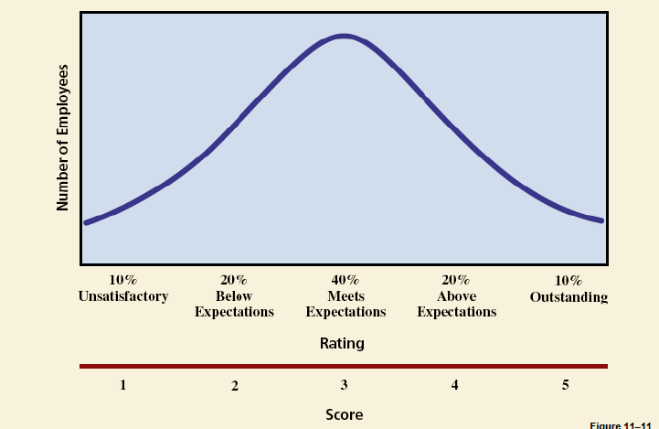
Forced Distribution a Bell -Shaped Curve

Slide 32
Narrative method
Critical Incident
Manager keeps a written record of highly favorable and unfavorable employee actions (positive and negative performance )
Drawbacks
Variations in how managers define a “critical incident”
Time involved in documenting employee actions
Most employee actions are not observed and may become different if observed
Employee concerns about manager’s “black books”

Slide 33
Essay
Manager writes a short essay describing an
employee’s performance.
Drawback
Depends on the managers’ writing skills and their ability to express themselves

Slide 34
Management by Objectives
Specifying the performance goals that an individual and his or her manager agree the employee will to try to attain within an appropriate length of time.
• Key MBO Ideas
Employee involvement creates higher levels of commitment and performance.
Encourages employees to work effectively toward achieving desired results.
Performance measures should be measurable and should define results.

Slide 35
The MBO Process
Job review agreement
Development of performance standards
Objective setting
Continuing performance discussion

Slide 36
Common Problems With the Performance Appraisal Process
Bias : Bias is simply a personality-based tendency, either toward or against something.
It resulted in subjective evaluation rather than objective.
It provide the opportunity for a lack of consistency in effect on different groups of employees
Stereotyping: Stereotyping is mentally classifying a person into an affinity group, and then identifying the person as having the same assumed characteristics as the group

Slide 37
Halo error. This error occurs when the evaluator has a generally positive or negative (negative halo error is sometimes called “horns error”) impression of an individual, and the evaluator then artificially extends that general impression to many individual categories of performance to create an overall evaluation of the individual that is either positive or negative.

Slide 38
Distributional errors. These errors occur in three forms:
severity or strictness,
central tendency, and
leniency.
They are based on a standard normal distribution, or the bell curve that we are all so familiar with.
In severity or strictness error,
The rater evaluates everyone, or nearly everyone, as below average.

Slide 39
Central tendency error: occurs when raters evaluate everyone under their control as average (nobody is either really good or really bad).
Leniency error: occurs when the rater evaluates all others as above average
Similarity error. This error occurs when raters evaluate subordinates that they consider more similar to themselves as better employees, and subordinates that they consider different from themselves as poorer employees.

Slide 40
Recently error. This error occurs when raters use only the last few weeks or month of a rating period as evidence of their ratings of others.
Contrast error. In contrast error, the rater compares and contrasts performance between two employees, rather than using absolute measures of performance to measure each employee.

Slide 41
Avoiding Performance Appraisal Process Problems
Develop Accurate Performance Measures
Use multiple criteria.
Minimize the use of trait-based evaluations
Train Evaluators
Train evaluators to overcome the common problems of assessment
Train evaluators to use the measurement methods and forms.
Use Multiple Raters

Slide 42
Requirement for effective performance appraisal system
Relevance
Clear links between the performance standards for a particular job and organizational objectives and
Clear links between the critical job elements identified through a job analysis and the dimensions to be rated on an appraisal form.
It should base on performance standards translate job requirements into levels of acceptable or unacceptable employee behavior.
Job analysis identifies what is to be done.

Slide 43
Sensitivity
The system should be capable of distinguishing effective from in effective performers.
Reliability (consistency of judgment).
Acceptability
Practicality: Appraisal instruments are easy for managers and employees to understand and use.

Slide 44
Characteristics for effective performance appraisal system
Clear Objectives:
The objectives of performance appraisal should be clear, specific, timely and open. The appraisal system should be fair and beneficial to both the individual employee and the organization should be linked with other subsystems of personnel management.
Reliable and Valid:
Appraisal system should provide consistent, reliable and valid information and date. Appraisals should measure wat they are supposed to measure. For example, if the objective of appraisal is to show potential of an employee for promotion, it should supply the date relating to potentialities of the employee.

Slide 45
3. Standardization:
The appraisal form, procedures and rules should be standardised. their should be well-defined performance criteria and standards. Employees should be made fully aware of these standards as appraisal decisions affect all employees of the group.
4. Training:
Evaluators should be given training in procedures and principals of appraisal. They should be provided with knowledge and skills in designing appraisals, conducting post appraisal interviews and correcting rating errors.
5. Job Relatedness:
The appraisal system should focus attention on job-related behaviour and performance. It should provide information on job related activities and areas

Slide 46
6. Mutual Trust:
Before introducing the appraisal system, a climate of mutual trust, cooperation and confidence should be created in the organization. Under the system, the employees should be treated in a supportive manner.
7. Feedback and Participation:
The ratings should be communicated to both the employees and the raters. The appraisal r system should be open and participative. The employees should get information on their performance. The system should involve employees in the goal setting process.
8. Help Focus:
Appraisal should not judgmental. It should not be purely control- oriented. The evaluator should also play the role of coach and counselor. He should- help people reach their full potential. The overall purpose of appraisals should be developmental.

Slide 47
9. Recognition of Differences:
Organization differs in terms of work, size, resources, needs and environment. Hence, the appraisal system must be designed to meet the needs of particular organization.
10. Post Appraisal Interview:
An appraisal system is only as effective as there is communications. Hence, an interview with the employee should be arranged after appraising his performance. It will help to know the difficulties of work and training needs of employees.

